Slide 1
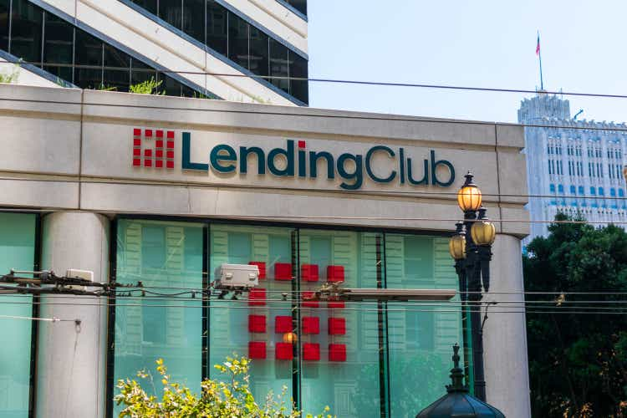

Sprint 1 – Capstone
Lending Club: Loan Approval Prediction
- Vidya
BrainStation

Slide 2
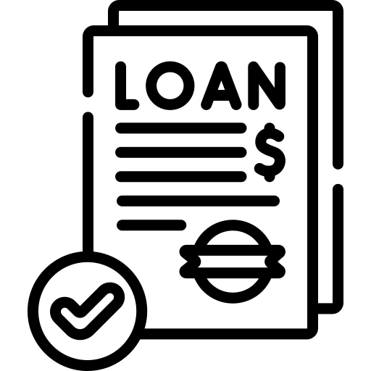
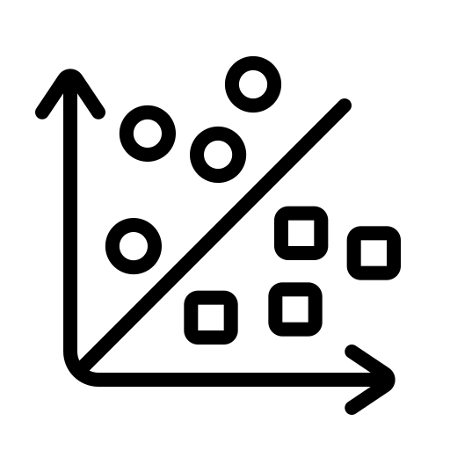


Automating Loan Approvals
Objectives
Objective 1: Predict Loan Approval at Banks
Objective 2: Identify loan features influencing likely approval.
Solution:
Approach: Utilize machine learning for Prediction
Data: Gather and analyze historical loan data
Modeling: Train a machine learning model on the historical data.
Predict: Determine the likelihood of Loan repayment
Impact:
Reducing human intervention in the loan approval process.
Expedite decision-making and improve the efficiency of sourcing customers

Slide 3
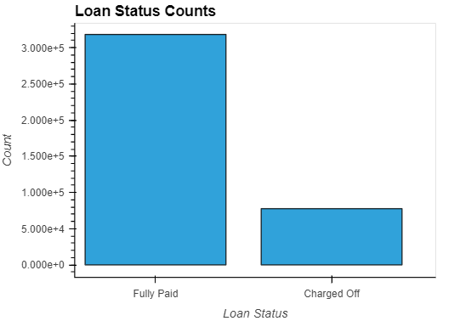
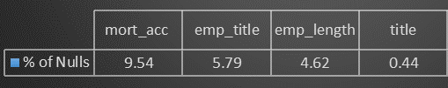
Data Preparation
Dataset: (300k, 27)
Issues:
Null values
Too many values in some categorical columns
Imbalanced data (80:20)
Outliers
Correlation
Feature Engineering
Earliest Credit Line (Month-Year)
Address (Street, City, Pincode)
Loan Issuance date (Month-Year)
Calculate Annual Income/Loan Amount
Calculate Annual Income/interest rate
Using Debt/Income to Debt

Slide 4
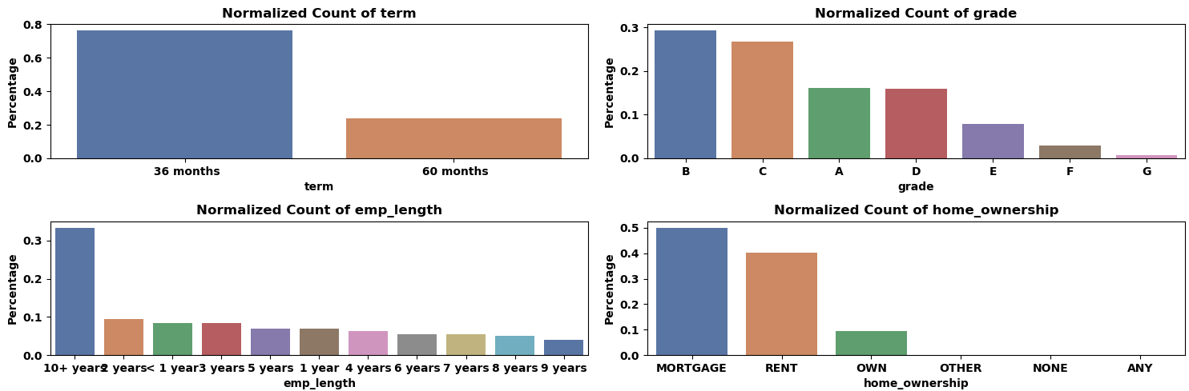
EDA (Categorical Data)

Slide 5
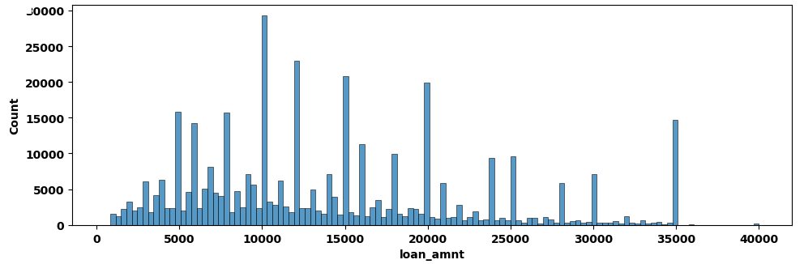
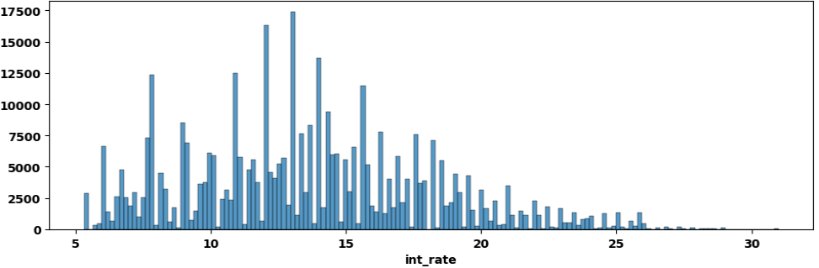
EDA (Numerical data)
Distribution of Loans by Loan Amount
Distribution of Loans by Interest Rate

Slide 6
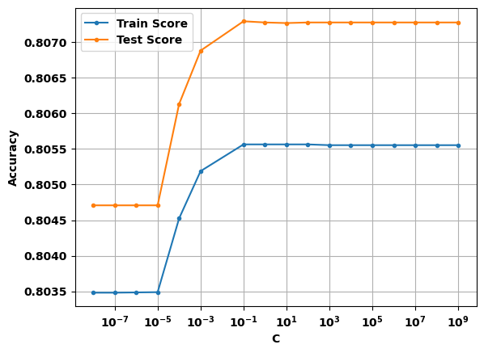
Baseline Models for Loan Approval Prediction
Logistic Regression
All features
C- Value

Slide 7
Next Steps
Dropping more columns
Run other ML models
Hyper Parameter Tuning
GridCV

